Slide 1
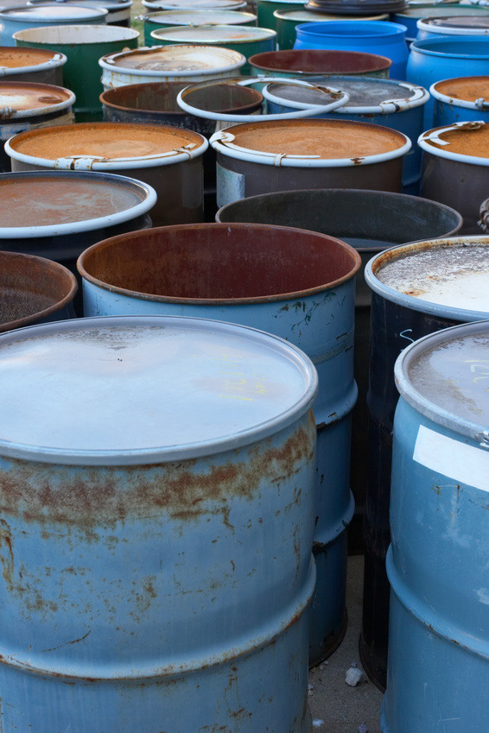
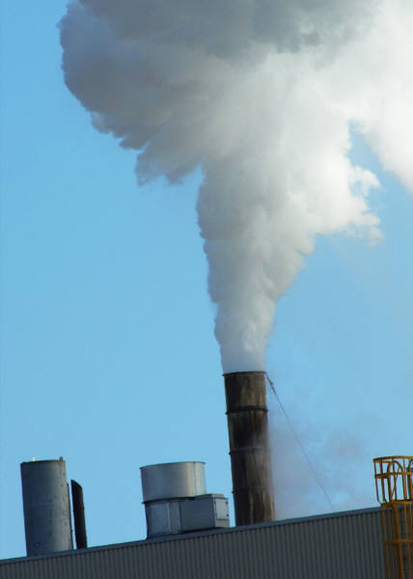
Risk Assessment in the Environment

Slide 2


What is the difference between hazard and risk?
Hazard: that which threatens our health or the environment
Risk: probability that an event or effect will occur and
  Combination of the possibility that an event occurs and its negative consequences

Slide 3

To Clarify: WE ALL TAKE RISKS!
For Example:
What is the likelihood that my son/daughter becomes sick with the flu when he/she comes in contact with other sick children at school?
What is the likelihood of falling down stairs that don’t have railings?

Slide 4

After identifying the Hazard and the degree of Risk, it is important to carry out a Risk Evaluation to determine what precautions we should take.

Slide 5

Other Important Concepts
Probability: likelihood that a certain result will occur
Uncertainty: lack of precise knowledge
Variability: difference between individuals

Slide 6

What is Risk Assessment?
Identify the Hazard to calculate the Risk
It is used to decide what actions should be taken to reduce the risks to health and the environment.

Slide 7
Who Uses Risk Assessment?
Everyone! Including you!

Slide 8
In Addition….
Various governmental agencies:
  US Food and Drug Administration (FDA)
  Occupational Safety and Health Administration (OSHA)
  US Environmental Protection Agency (USEPA)
Some industries/companies:
  To accomplish the protection of workers
  To determine if a product can be marketed
  and sold

Slide 9


Principal Components of Risk Assessment
Hazard Identification
Dose-Response Evaluation
Exposure Assessment
Risk Characterization

Slide 10

Hazard Identification

Slide 11

What Can We Ask Ourselves?
We ask ourselves:
  Is there a hazard?
  Are we exposed to the hazard?
  What is the risk associated with that exposure?
  What is the likelihood of that hazardous event happening?
  What are the consequences and how much harm may occur if that hazardous event happens?

Slide 12


How Do We Identify a Hazard?
Recognize if it is a threat to our health
  For example:
  Mold in our home
  A chemical in the drinking water of our community that is close to a factory
  Lead-contaminated paint on an old house

Slide 13
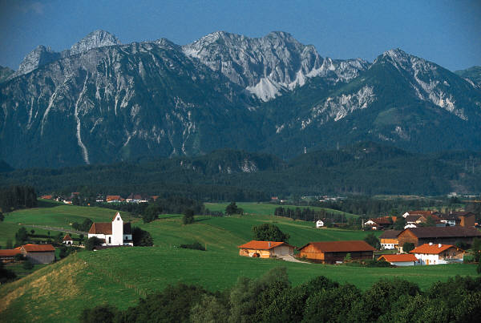
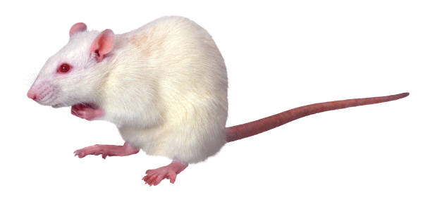
Hazard Identification
It is important to know the precautions that should be taken
How are the effects of a hazard determined:
  Animal Models (in vivo or animal testing)
  Real-life situations (case studies or epidemiological studies)

Slide 14
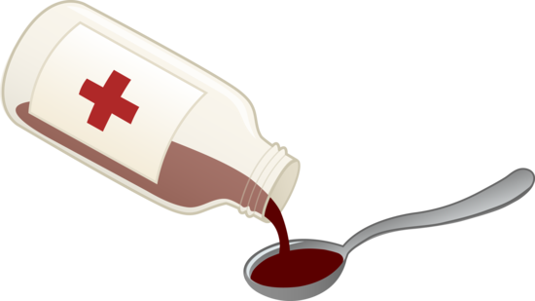
Dose-Response Evaluation

Slide 15


Types of Hazards Found in the Environment
Usually the more you are exposed to these hazards, there is more risk to your health
Types of hazards include:
  Physical Hazards
  Chemical Hazards

Slide 16
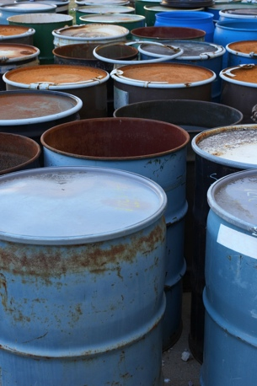
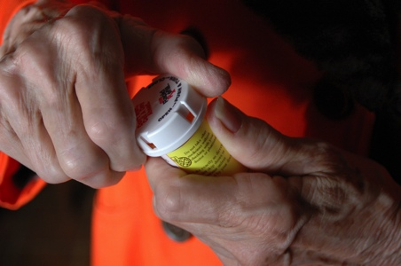


Dose-Response
You can be exposed to a small amount for a long time to:
  Cause harm (negative response)
  Also, you may be exposed to a large amount for a short time to:
  Cause the same effect

Slide 17




Classifying Chemical Toxicity
“A” is more potent than “B”
“B” is more potent than “C”
Habanero
Jalapeño
Red Pepper
A
C
B
Response
0 1 2 3 4 5 6
Dose (Exposure)

Slide 18



Dose-Response Curve for Chili Peppers
100
Response
50
0
1 2 3 4 5 6 7 8
Quantity (Dose or Exposure)

Slide 19
Chemical Substances Usually have Two Types of Health Effects
Noncarcinogen
  It is treated as a point below where it is estimated that cancer may develop
    The effects can be other types, such as:
      Skin rash
      Heart problems
      Diabetes
Carcinogen
  It is treated as something that always has a negative risk
If a chemical is labeled as carcinogenic or non-carcinogenic, this label can change in regards to the available information.

Slide 20

Example: Carcinogen
Cancer is treated as something that has no "safe" level
There is always a possibility of risk with an increase of the dose
It is common to put the risk of a chemical in terms of probability:
  1 person in 1 million people runs less risk than 1 person in 100 people

Slide 21

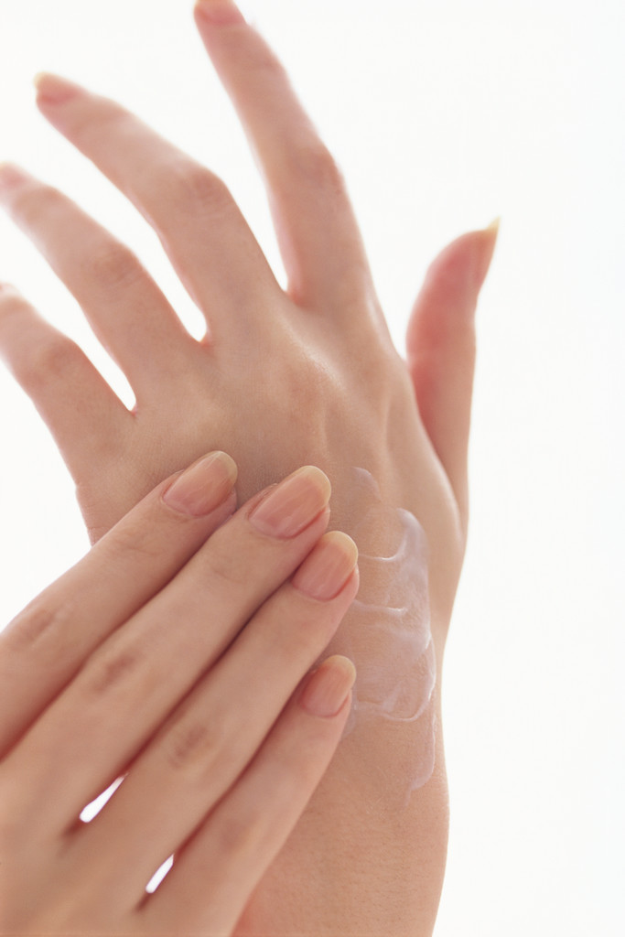
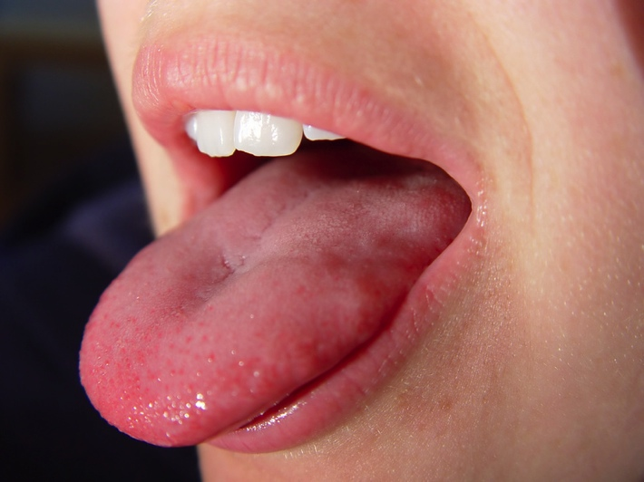
Exposure Assessment

Slide 22




Exposure Occurs When We…
Come into contact with the hazard
Direct contact such as:
  Touch (skin)
  Breath (inhale)
  Eat/drink (ingest)

Slide 23
Principal Components of Exposure
DEGREE or AMOUNT of hazard you are in contact with:
  Concentration of a chemical substance
    For example - Amount of mold in a home
    For example - Number of objects that you can stumble or trip on
The amount of TIME you are in contact with the hazard:
  How long are you inhaling the chemical?
  How much water do you drink or food do you ingest and how often?
  How much time do you spend in your home that contains mold?

Slide 24
If you are exposed does it mean that you will be affected?
Not Necessarily

Slide 25
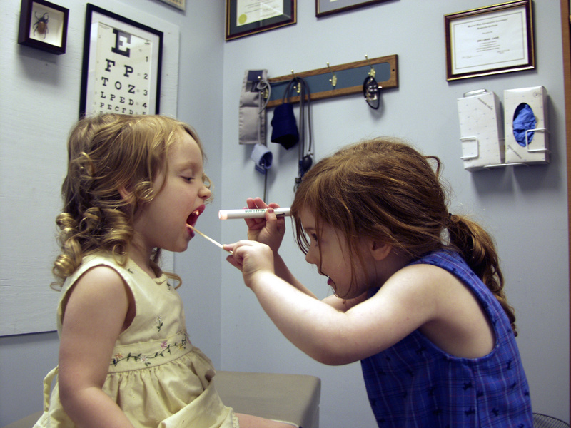
How Do You Evaluate Exposure?
Calculating the amount of a chemical that you'll be breathing, eating, drinking, or absorbed through the skin
For example:
  Amount of a chemical in a sample of drinking water or air collected at a home
  How much water you drink or how much air you breath

Slide 26

How Do You Evaluate Exposure?
We have to consider how long the person has been exposed to danger
High-risk populations are most affected
  For example, children or the elderly

Slide 27
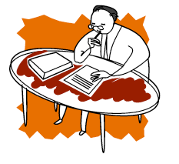
Risk Characterization

Slide 28

How is Risk Characterized?
We can estimate how much risk a person may face when:
  We have information on exposure to a hazard and how it could affect health
In some cases, we compare the exposure safety guidelines already established
For example:
  Exposure to a chemical at work is higher than that allowed by OSHA
  Amount of lead in drinking water is higher than allowed by US EPA

Slide 29
What Should Also be Considered When Implementing the Risk Assessment Steps?
Variability
  Differences between people and differences between where they live
  Difference between exposure and difference between the effects that manifest
  Uncertainty
  Lack of perfect knowledge
  Uncertainty between the exact exposure
  Uncertainty between exposure responses

Slide 30
How Do We Deal with Variability and Uncertainty in Risk Assessment?
Try to get as much data as possible
Try to identify all the people who have been exposed
Try to collect chemical samples on different days
  Try to identify as many characteristics of a population that may affect the response to a chemical (e.g., lifestyle)

Slide 31

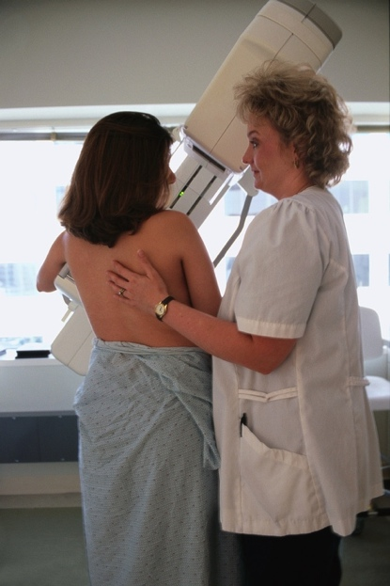

Example of Variability
Not all cigarette smokers develop cancer
Women are more likely to develop breast cancer than men
You drank three cups of coffee yesterday but today only one cup

Slide 32

More About Uncertainty
We need to better understand how chemicals affect health:
  Many scientific studies are needed to understand certain hazards
  Many times we do not have enough studies or knowledge
Exposure to other hazards may increase the risk of certain health problems

Slide 33
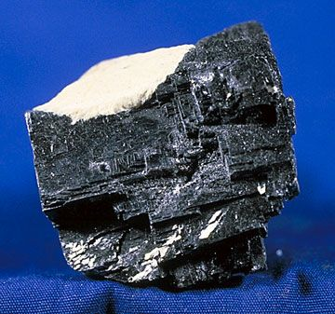
Putting it into Context:
Example - Lead
Metal found naturally in the Earth's crust
Some of the health effects are:
  Slow mental and physical development, anemia, stomach problems, kidney damage
Assessing the risk of lead can include an assessment of the home:
  Houses built before 1978 are considered to have lead paint
  Houses built before 1986 are more likely to have old plumbing supply lines and lead solder
Notes:
Un metal

Slide 34

Putting it into Context:
Example - Lead
Measuring lead in blood is a way to measure exposure
Variability in the risk assessment process can come from:
  Different exposures by different people
  Different characteristics of a household
Uncertainty in the risk assessment process can come from:
  Quantification of the effects
  Genetics and lifestyles

Slide 35
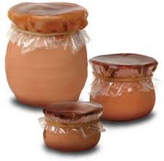
How to Decrease Exposure to Lead
Be informed about products that may contain lead in your home:
  Candy, natural remedies, toys, ceramics
  If you work with lead it is very important to bathe and change clothes after work
  Use cold water from the tap for drinking and cooking
  Sample wall material before remodeling to ensure it does not contain lead

Slide 36
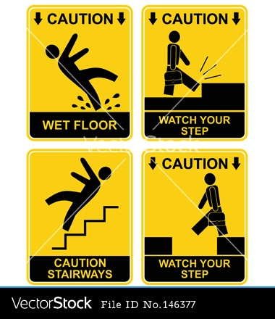
Putting it into Context:
Example - Falls
Falls can cause injuries
They are especially dangerous for children and the elderly
A risk evaluation of fall in a home can include:
  Observe the area of​interest and note where people can trip, slip or fall, having a negative effect

Slide 37
Putting it into Context:
Example - Falls
Risk assessment includes knowledge of past history of a location as well as pathway hazards
Variability in the risk assessment process can come from:
  Number of times a person walks through the area
Uncertainty in the risk assessment process can come from:
  Person can have different effects from the fall (depends on health and lifestyle)

Slide 38

What Can We Do To Prevent Falls?
Remove things from pathway
Ensure that floors are not slippery
Ensure that areas inside and outside are well lit, particularly in the areas near stairs
Have handrails on stairs (preferably on both sides)
Install grab bars in shower/tub area

