Slide 1
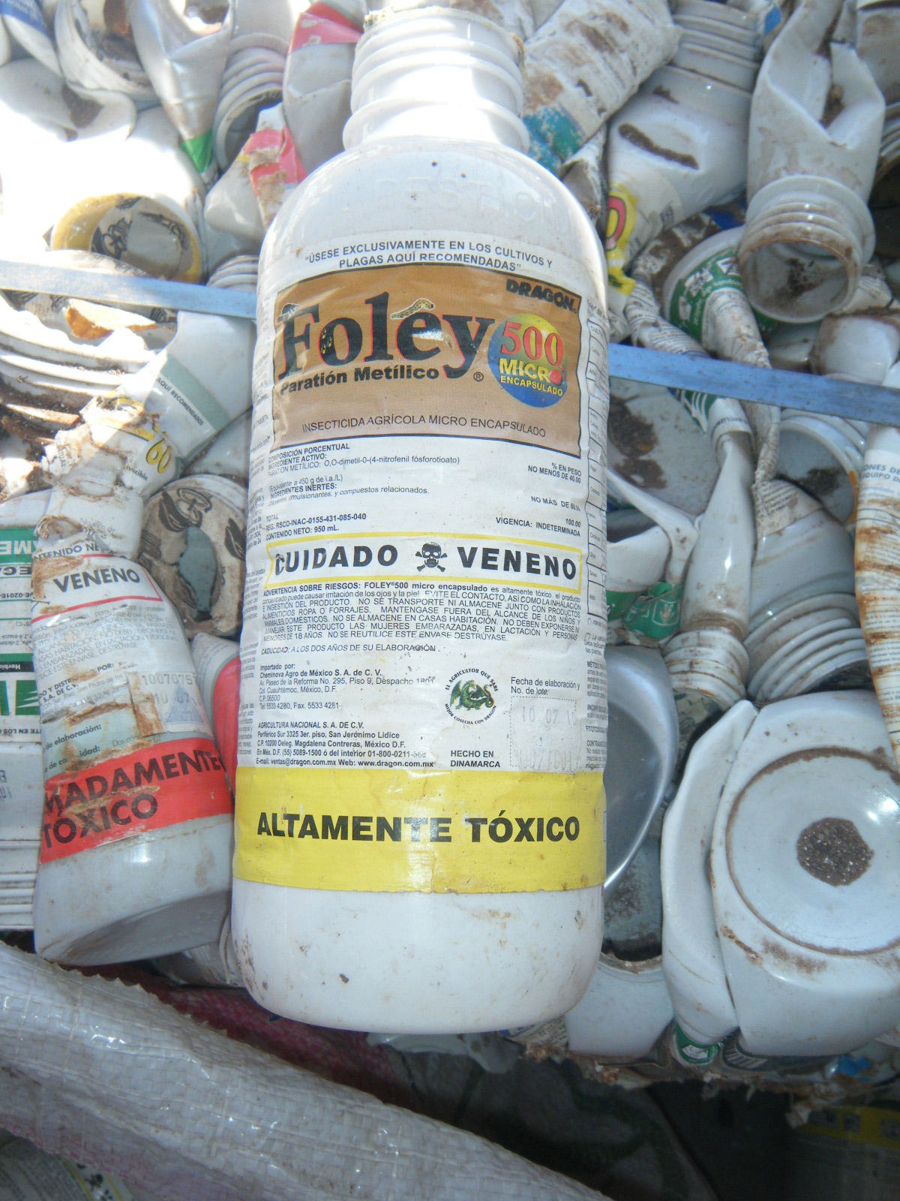
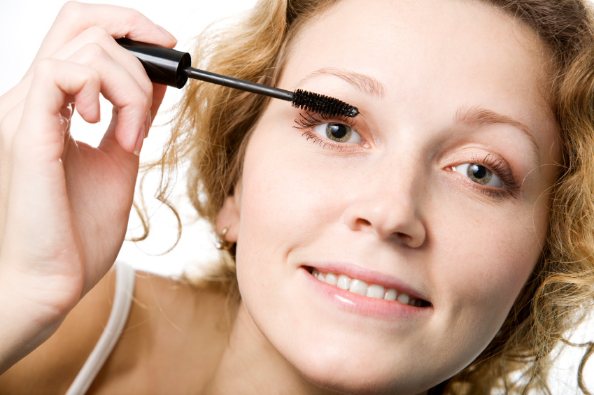
Principles of Environmental Toxicology
Every day interactions with our surroundings

Slide 2
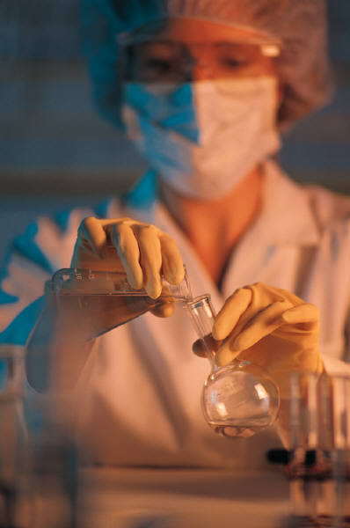
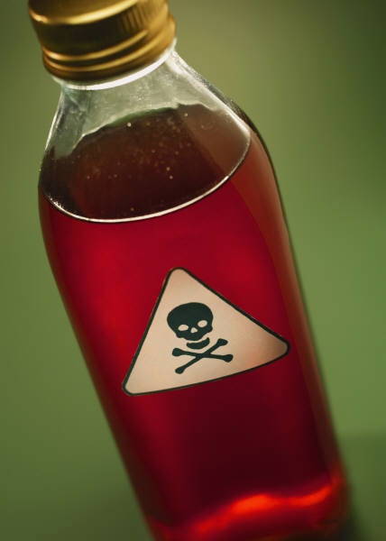
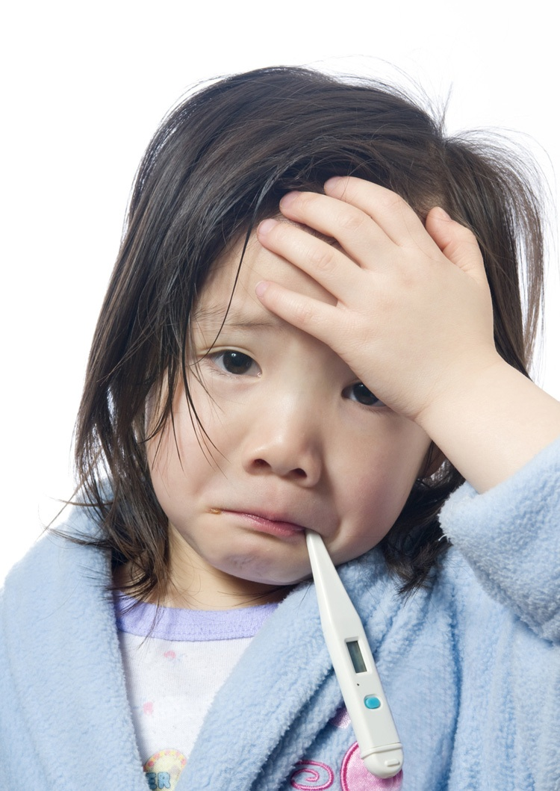
Basic Definitions:
Toxicology
Toxicity
The study of bad effects on living systems.
The negative effects in the living system.

Slide 3
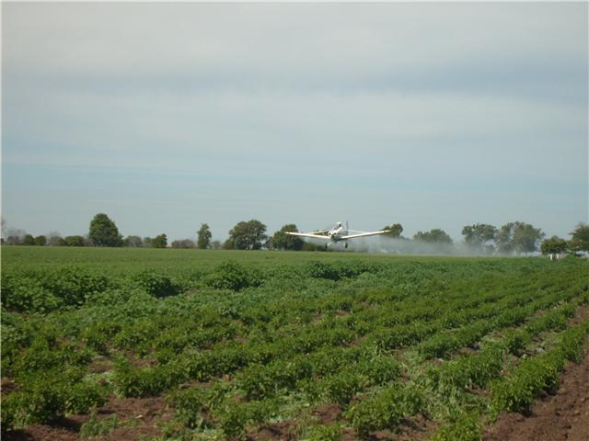
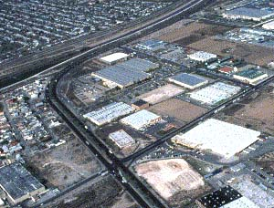
Environmental Toxicology
The study of the effects of industrial and agricultural toxins on human health and the environment.

Slide 4
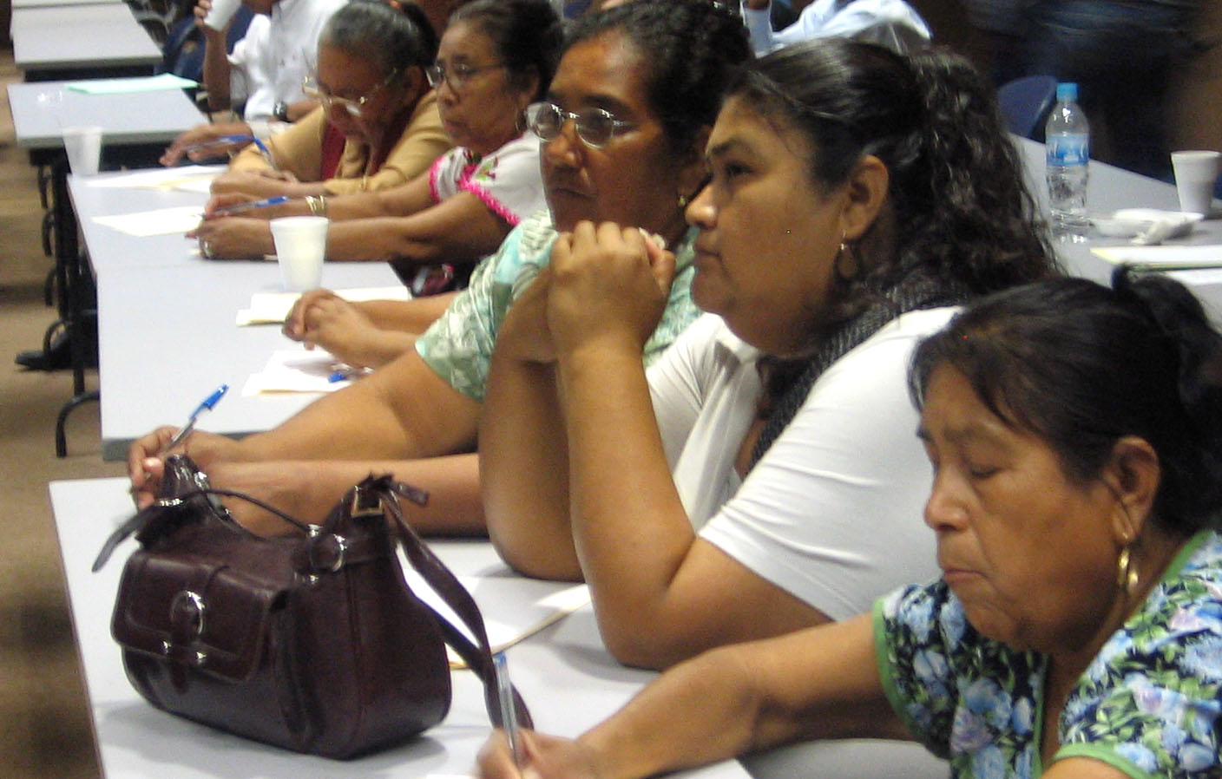
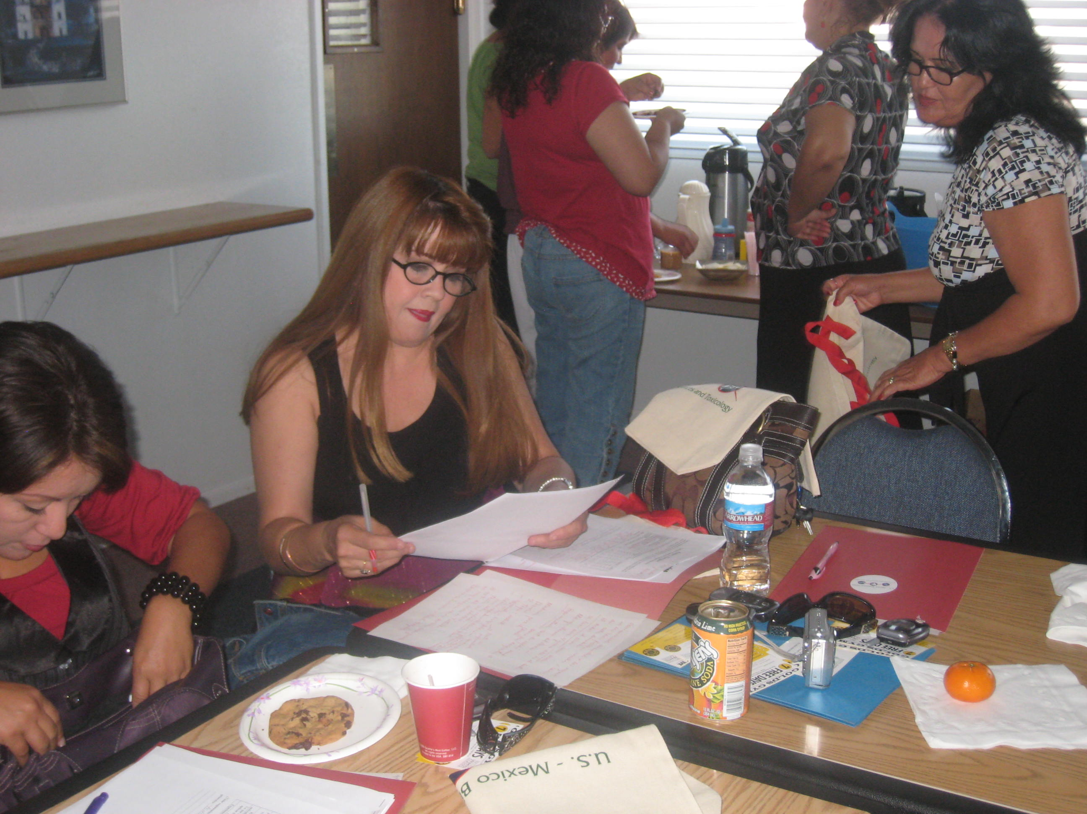
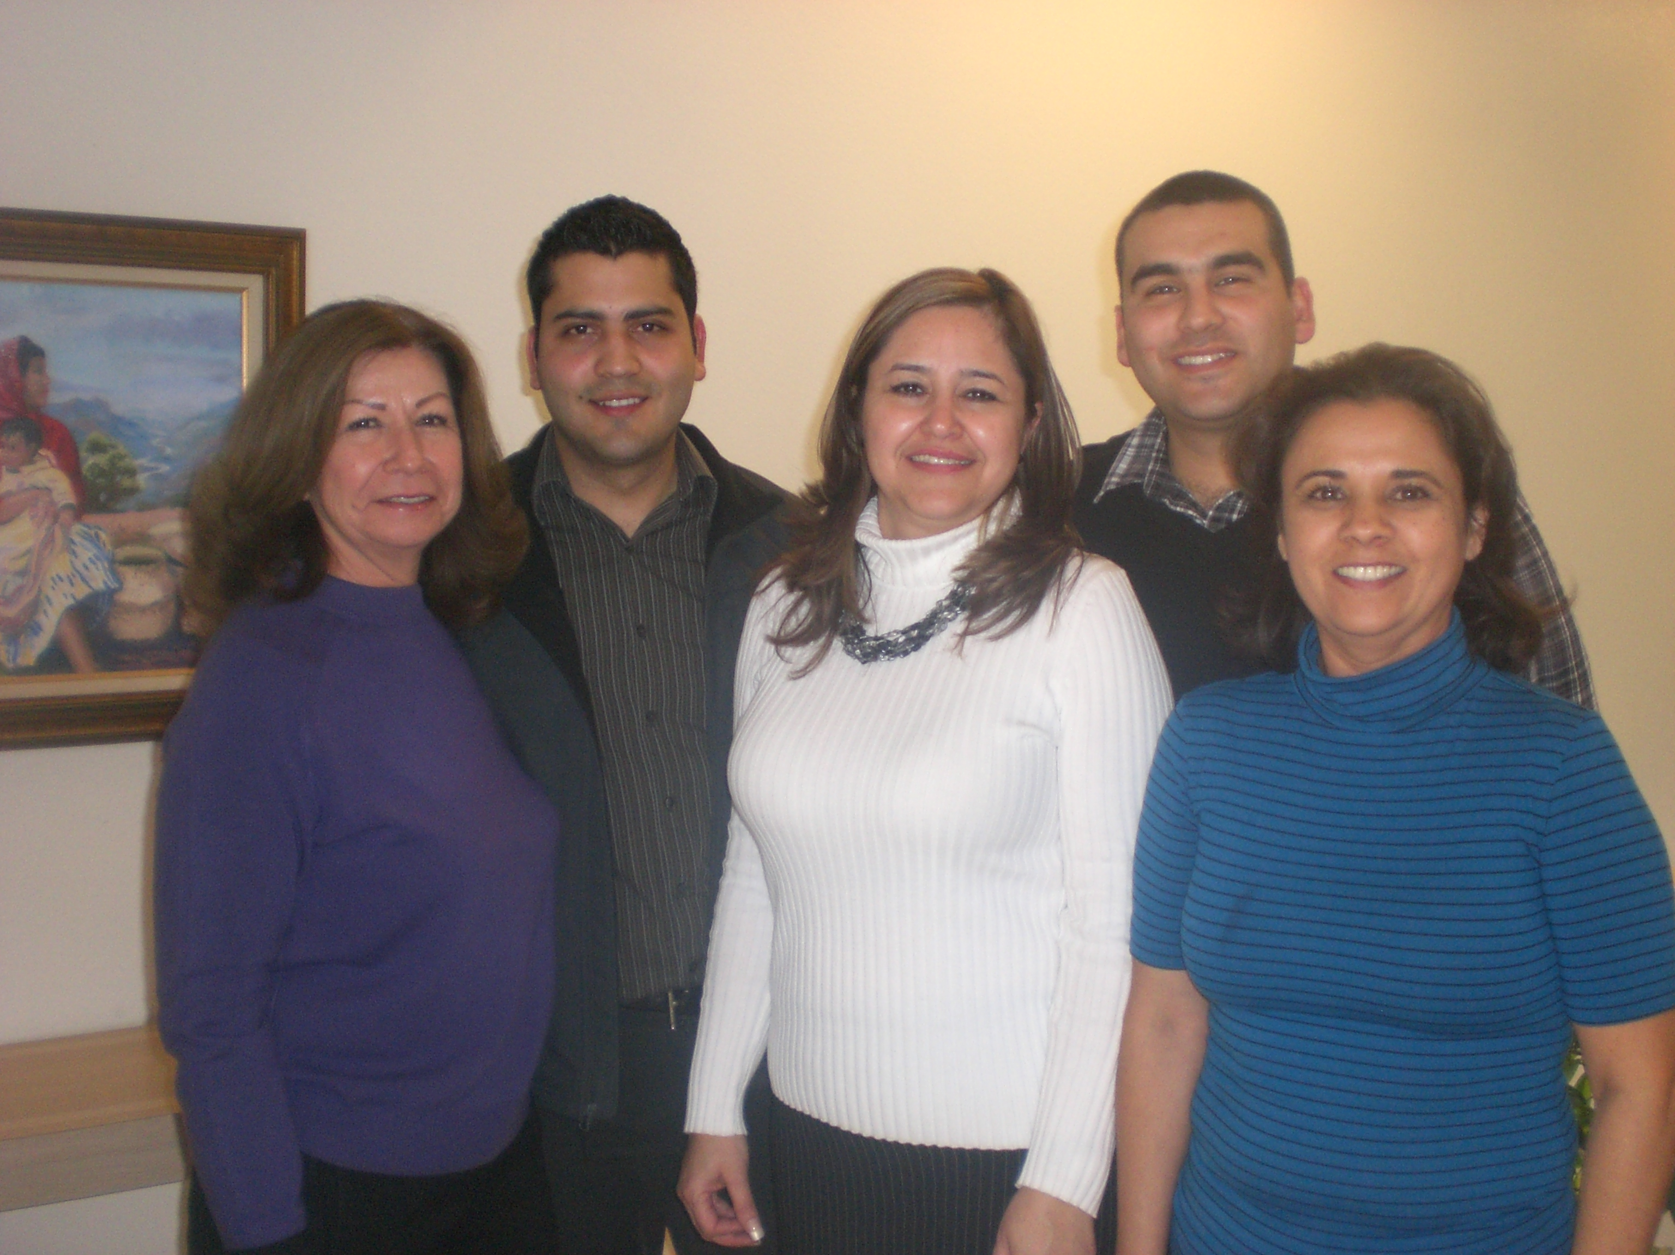
WELCOME TOXICOLOGIST!
YOU ARE ALL TOXICOLOGISTS

Slide 5
EVERYTHING IS TOXIC!
It is the amount of exposure that determines toxicity!
Table Salt
1 pound → toxic, lethal
Tequila
1 quart → toxic, possibly lethal
Rat Poison (Strychnine)
1 tablespoon → toxic, lethal

Slide 6
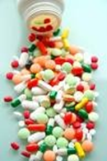
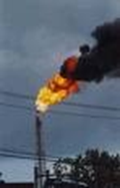
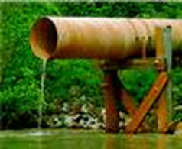
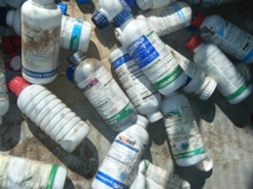
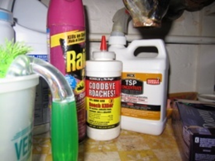
Toxic Chemicals
Medicines
Environmental Pollutants
Industrial Chemicals
Agricultural Chemicals
Household Chemicals

Slide 7
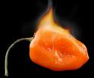



Ranking Chemical Toxicity
“A” more potent than “B”
“B” more potent than “C”
A
B
C
Habanero Chile
Jalapeño Chile
Red Pepper
Response
0 1 2 3 4 5 6 7
Dose (Exposure)

Slide 8

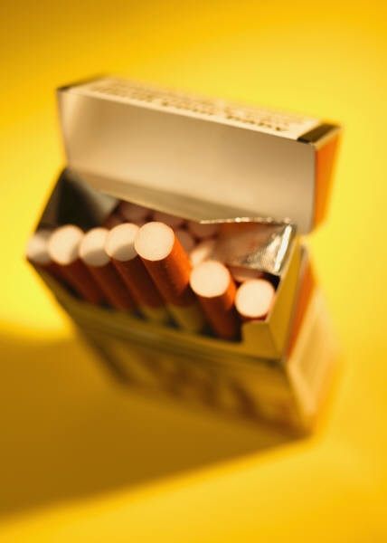
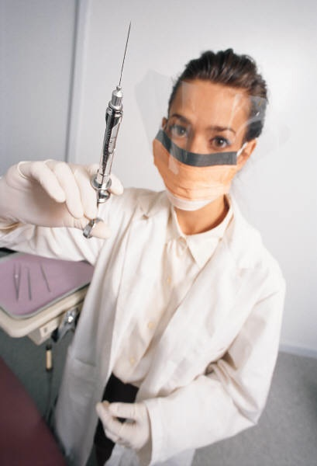
Spectrum of Toxic Doses
Everything is toxic!
Dose determines the toxicity.
Chemical | Toxic Dose (mg/kg*)
Ethanol | 10,000
Salt | 4,000
Morphine | 900
DDT | 100
Nicotine | 1
Curare | 0.5
Dioxin | 0.001
Botox | 0.00001
*mg/kg is equal to one milligram of chemical per one kilogram of body weight.

Slide 9



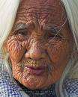
Toxicity – We Are Not All the Same
Effects of Biological Variation:
5
4
3
Number of People
Showing a Response
2
1
0 1 2 3 4 5 6 7
Dose

Slide 10

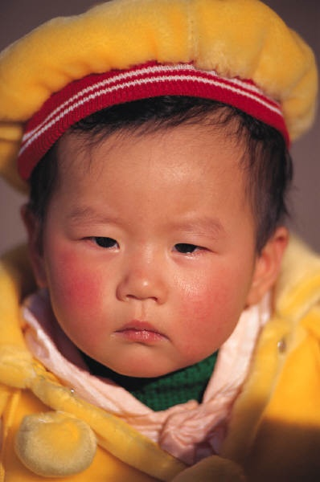


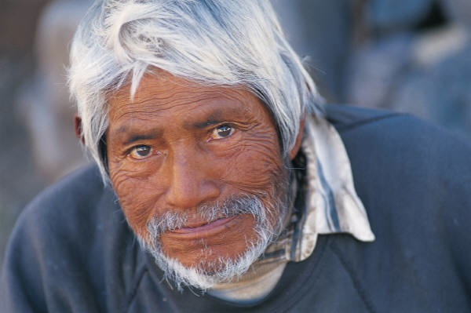
Exposure
Acute
Chronic
Occurring quickly such as:
  Hours
  Days
  Weeks
Long-term; effects take a long time to occur
For example cancer
(e.g. headache)

Slide 11




Acute Toxicity – Quick Occurring
Example:
  Alcohol (beer, wine, liquor)
    Effects within 30 minutes.
    The more that you drink, the more the effects:
      Relaxed
      Happy
      Confused
      Difficult to walk
      Sick - vomit
    Recover from the toxicity.
Other toxicity: Food poisoning – sick in 4-6 hours or sick overnight.

Slide 12
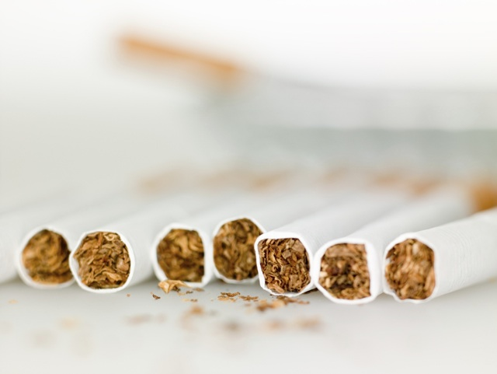
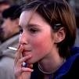

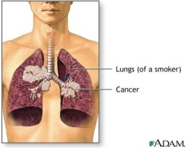
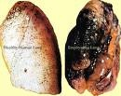
Chronic Toxicity – Slowly Occurring
Example:
  Cigarettes
    Long-term smoking
    Everyday exposure
    After many years – health effects develop slowly and appear unexpectedly:
      Lung cancer
      Emphysema
      Cancer – other organs
Other chemical substances: Trichloroethylene (TCE) → Cancer
Air Pollution → Asthma
Sun (UV Light) → Skin Disease

Slide 13
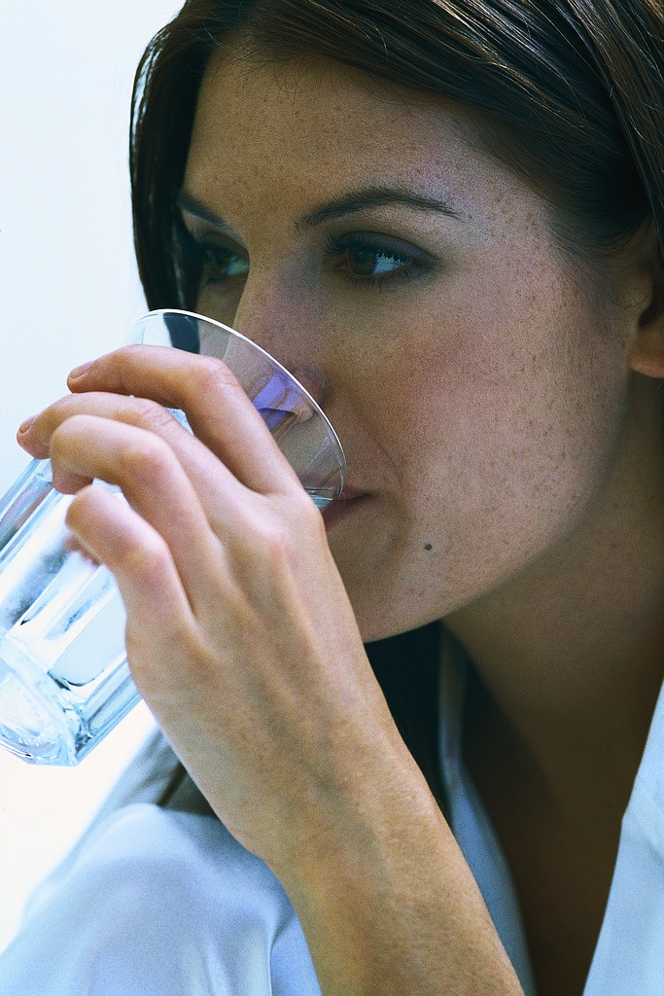
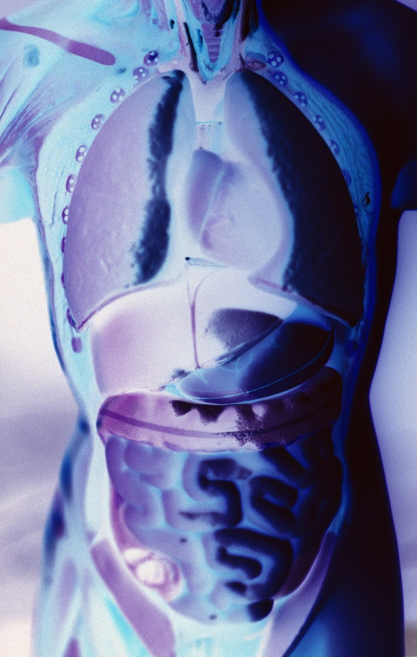
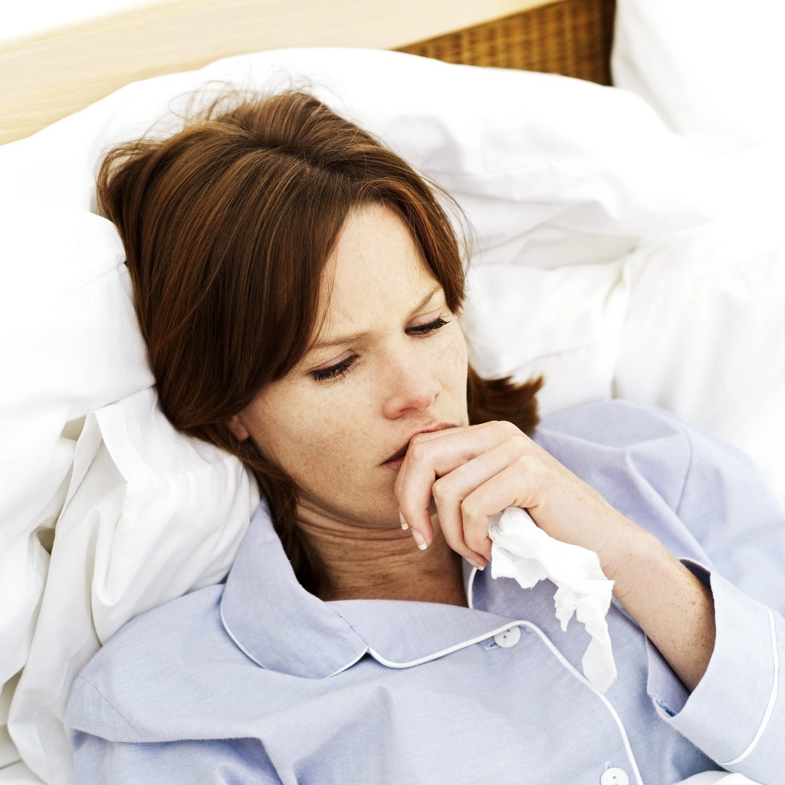
Toxicity Episode Phases
When an organism is exposed to a toxic substance, it follows phases of toxicity.
The phases are the following:
  Exposure Phase
  Processing Phase
  Expression Phase

Slide 14



Dose-Response Curve of Chili
100
Response
50
0
1 2 3 4 5 6 7 8
Quantity (Dose or Exposure)

Slide 15
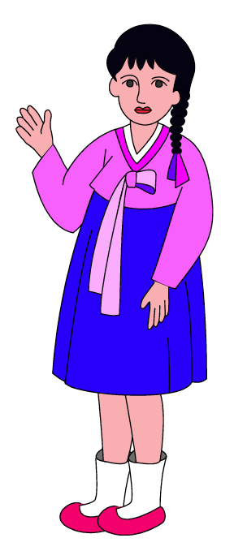
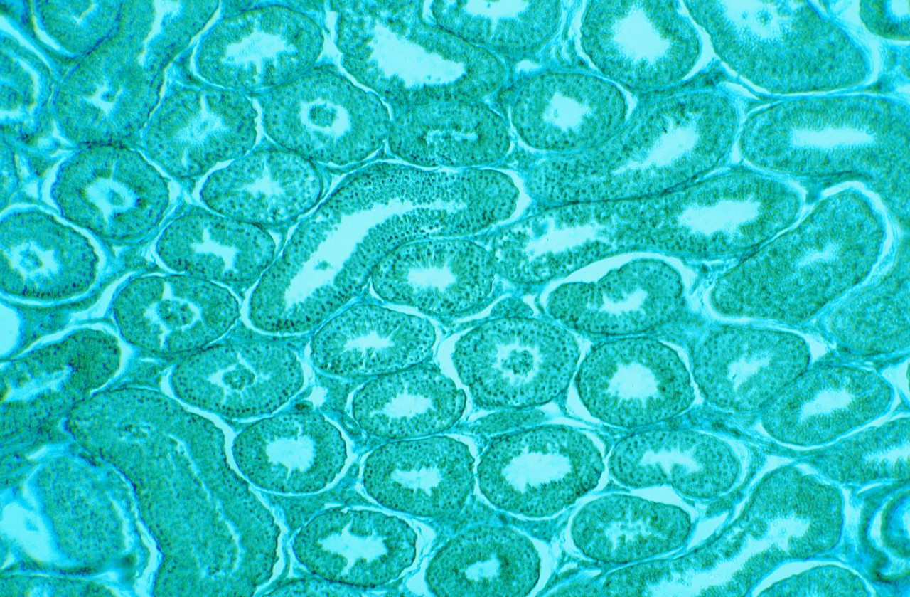

Exposure Phase
Uptake from:
  Stomach – intestines
  Lung – inhalation
  Skin – dermal
  Mucus – ear or nose
Chemical must get into the body (enter human cells) or be available to have an effect.
Chemicals vary in how well they move into the body (enter human cells).
Exposure
Move into tissues (cells)
Enters blood stream

Slide 16
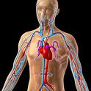
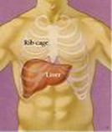

Processing Body Phase
People vary in how well they process chemical.
Some chemicals are removed from the body very slowly.
Blood moves the chemical around the body
Chemical tends to accumulate in selected tissues
Body tries to rid itself of these chemicals

Slide 17
Toxicity Expression Phase
Large range of toxic effects:
  Appearance
  Physical ability
  Weight or growth
  Mental/neurological
  Internal – organ
    Organ function – e.g. kidney
  Lesion - cancer
DIFFERENT CHEMICALS GIVE DIFFERENT SYMPTOMS

Slide 18

Toxicologist are like Detectives
We do not always know the specific chemical exposure!
Example Scenarios:
  People become sick working in a factory…
  People become sick in an area on the same drinking water…
Toxicity Detective have to “link” the toxic effects:
  To the chemicals that can cause these effects.
  To multiple chemicals we come into contact everyday (large majority):
    Automobile exhaust
    Cigarette smoke

Slide 19
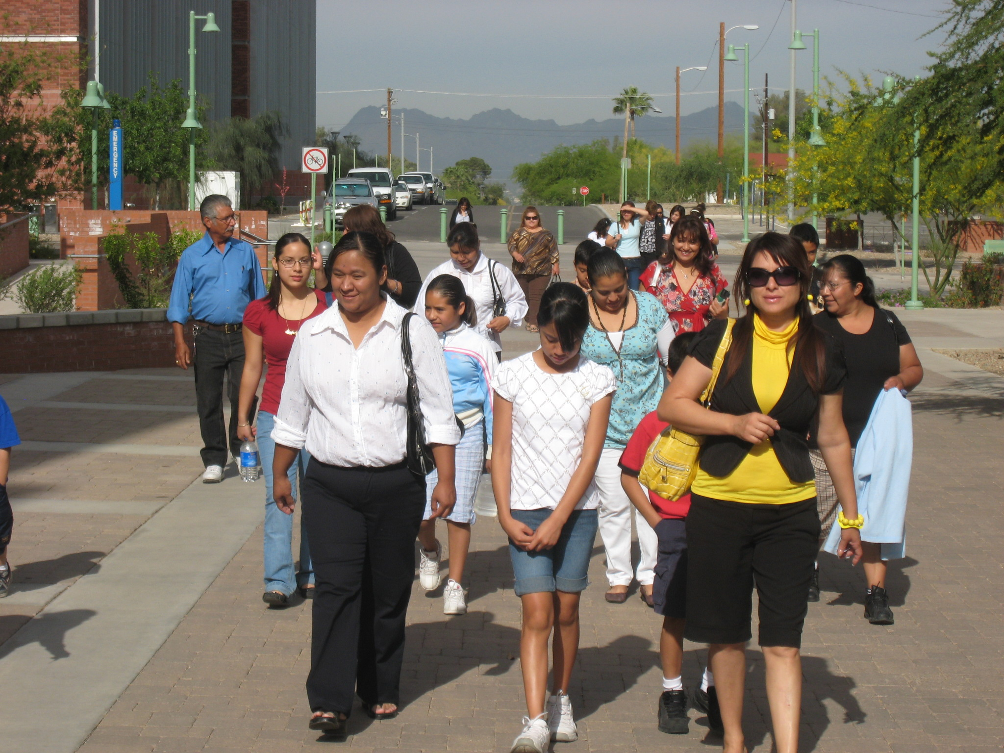
Real Life Toxicology Concerns
Examples*:
TCE in water (Tucson)
PCE in water (Nogales)
Pesticides in air (Ciudad
Obregon/Somerton)
Arsenic in water (Arizona)
Response
This is the
amount we are all exposed to
Dose (Exposure)
Low level exposure
Long time exposure
Slow development of toxicity
*Past and present examples

Slide 20
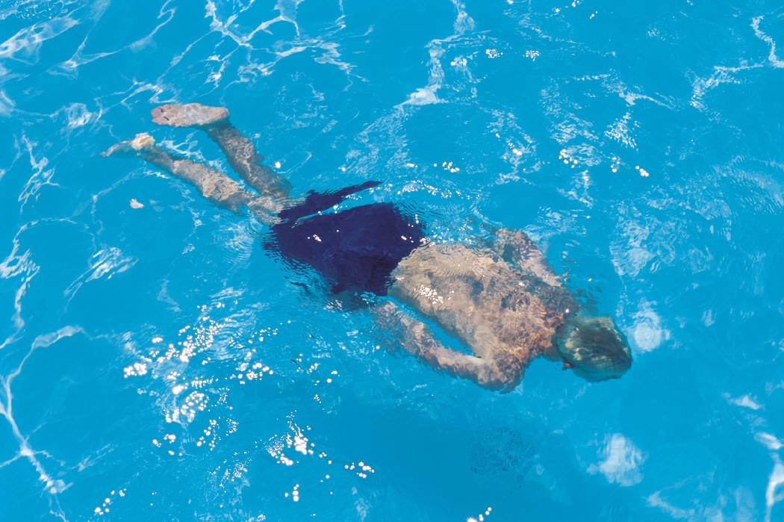
Are We Safe?
What is a safe level?
  No adverse (bad) effects!
Example - Chlorine in a swimming pool:
  Chlorine levels are enough to kill bacteria.
  Chlorine not at levels to harm swimmers.
What is a safe level for…
  Arsenic in our drinking water?
  TCE in the soil?
  Pesticides in our food?

Slide 21





To Solve the Problem We Need:
Science
Politics
Keep Our Home Safe
Economics
Everyone

